Slide 1
72” dia., 8 person rated, Dual Lock Clinical Multiplace Hyperbaric System
Offered by
Hyperbaric Clearinghouse, Inc.
www.hyperbaric-clearinghouse.com
HCI Reference: AN-518, R2
Effective Date: December 1, 2021
Applicable Rules
NFPA 99, Chapter 20/14 “Hyperbaric Facilities”
ASME-PVHO-1 “Safety Code for Pressure Vessels for Human Occupancy

Slide 2
72” dia., Multiplace HBOT System
Key Features
72” ID by 18 feet overall length, built 2005
6 ATA operating pressure rating
Manufacturer (HyperTek) states the system is NFPA 99 compliant
Main (Treatment) Lock is currently outfitted for 8 patients and 1 attendants.
Full Service Entry Lock is outfitted for 2 patient and 1 attendant.
Rectangular patient entry door to Main Lock
36” Diameter Round doors from Main Lock to Entry Lock and Entry Lock to exterior.
Easy-to-use rolling door pass-thru lock to Main Lock.

Slide 3
72” dia., Multiplace HBOT System
Main Lock/Chamber
• Bunks for four patients converting to seating for 8 patients
• Built In Breathing System (BIBS) w/overboard dump, 10 sets)
• Deluxe powder coated control console
• CO2 analyzer (Drager hand held)
• Oxygen analyzer w/high & low alarms
• Communication & entertainment system, w/float charger
• Sound powered phone systems
LED fiber optic lighting system
Fire suppression system (FSS) water deluge ( FOG SYSTEM) & hand lines as per NFPA-99-2012 Chapter 14

Slide 4
72” dia., Multiplace HBOT System
Also included are:
Fire suppression water tanks and related controls
NOT included are
Manifolds for reserve breathing air and oxygen supplies
Oxygen supply system. In larger health care facilities, the chamber can often be supplied by the existing central oxygen supply system. In free-standing sites and smaller medical facilities, a dedicated oxygen service is usually required.
Recommended NFPA compliant air plant consisting of duplex compressors capable of producing a total of 102 scfm at 121 psig and required volume tanks, dryer, and volume tanks.
An option for an oxygen concentrator system capable of supporting 4 patients on a continuous basis for up to 6 hours, up to 8 on a surge basis is now available. Very cost-effective for locations where oxygen is expensive, such as island communities.

Slide 5
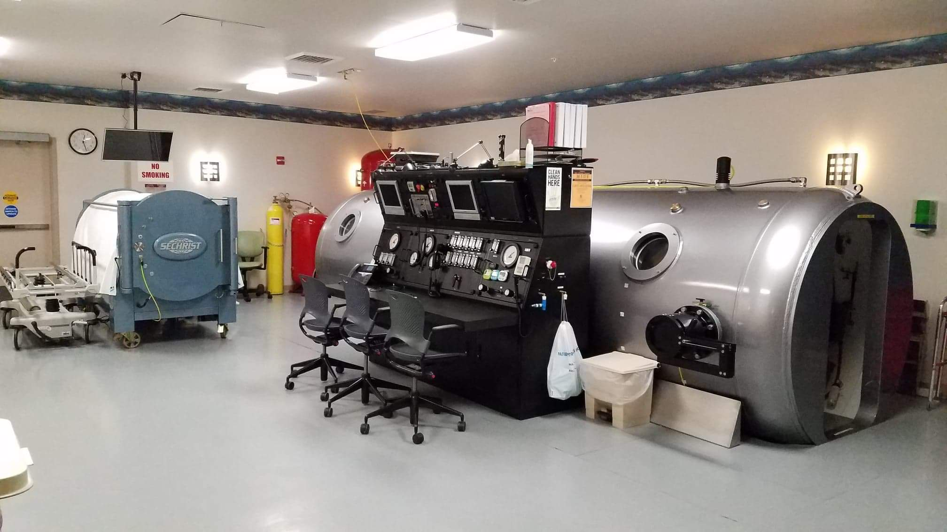
Another exterior view of the chamber, as installed in its previous location

Slide 6
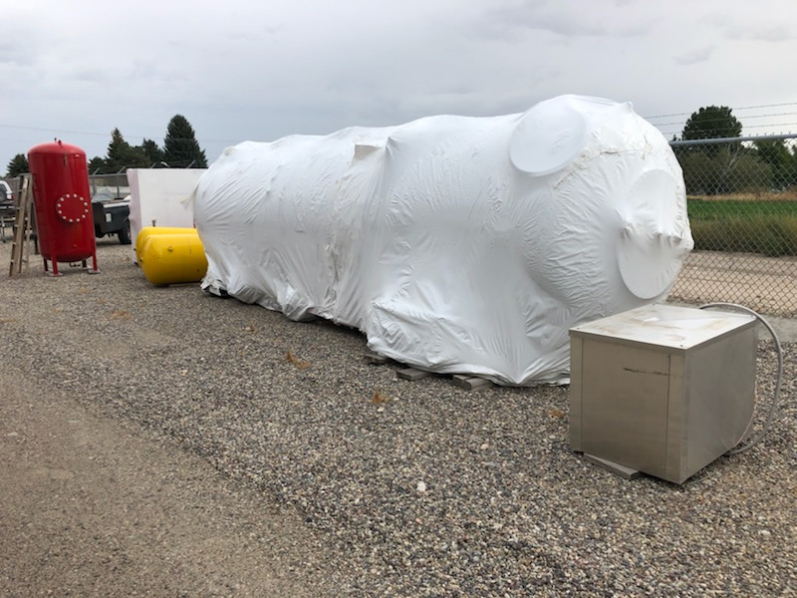
Prepared for Shipping

Slide 7
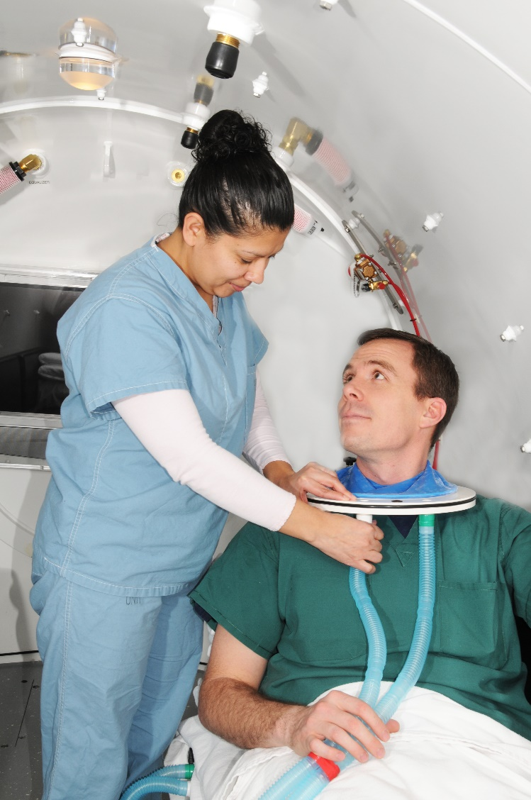
Main Lock Interior

Slide 8
Main Lock Interior
The hood connections are along for front of each bench. Hood flows are controlled from flowmeters on the main operating console.

Slide 9
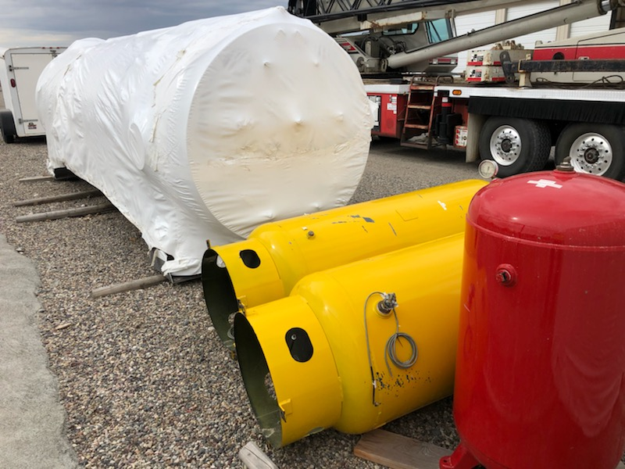
Chamber, Compressed Air Receivers and Hand Line Water Tank

Slide 10
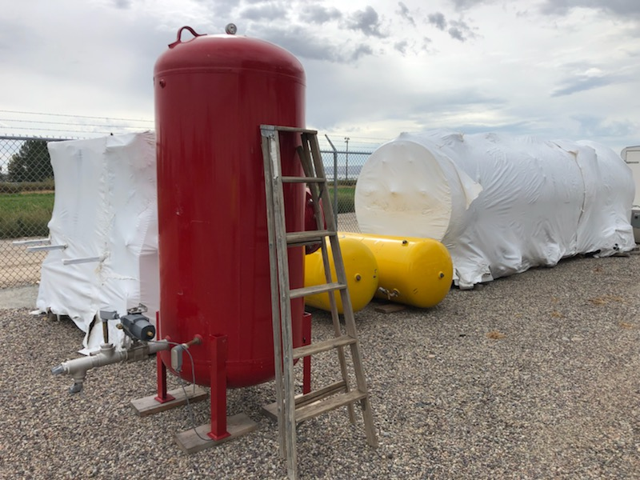
Fire Suppression Deluge System Water Tank

Slide 11
Chamber, Control Console, Tanks on Truck

Slide 12
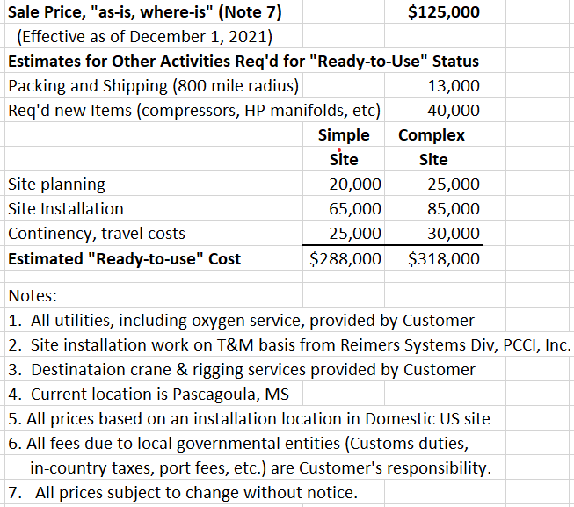
Budgetary Pricing

